Slide 1
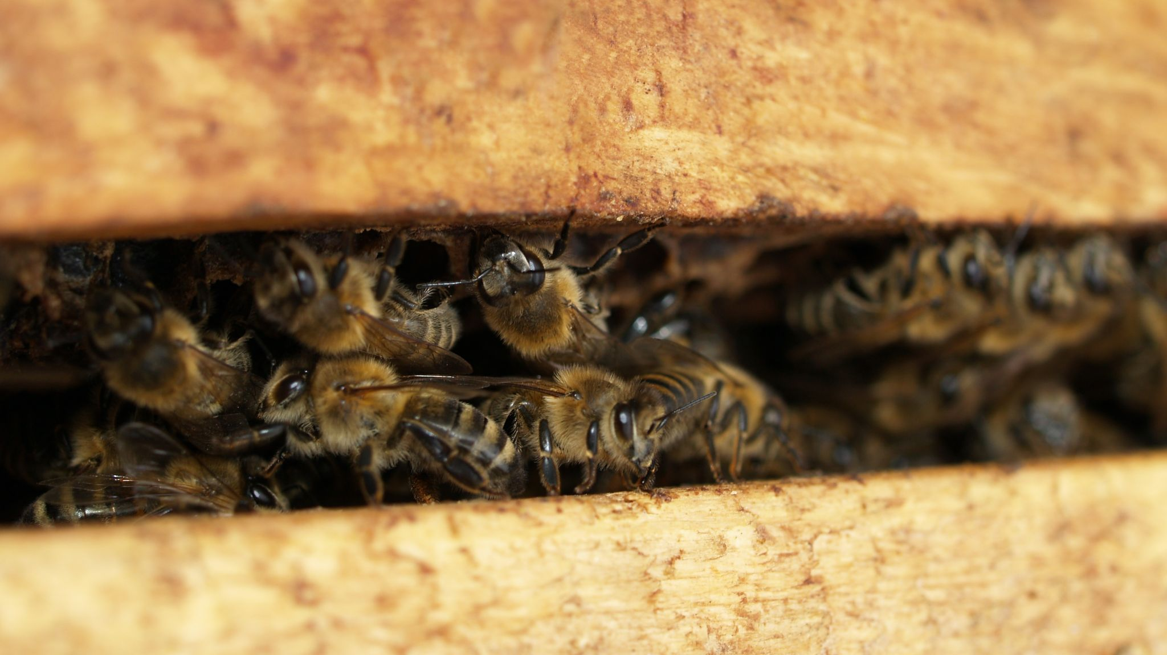
Bee Colony Loss
By………..

Slide 2

Data Set
Data from 2010 to 2017 of the percentage of bee keeper’s colonies that have died out by state.
SIZE - 365 instances, 8 attributes
16 missing values in 1 attribute

Slide 3
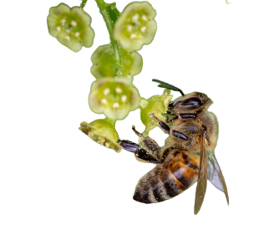
Attributes
Nominal
Year (2016/17)
Season (Annual)
State (Massachusetts)
Numeric
Total Annual Loss (0.159)
Beekeepers (87)
Beekeepers Exclusive to State (0.943)
Colonies (27186)
Colonies Exclusive to State (0.023)

Slide 4

Preprocessing
Converted file from xlsx to csv to arff
Converted percentages to decimals
Removed “Season” attribute
Removed instances with missing values

Slide 5
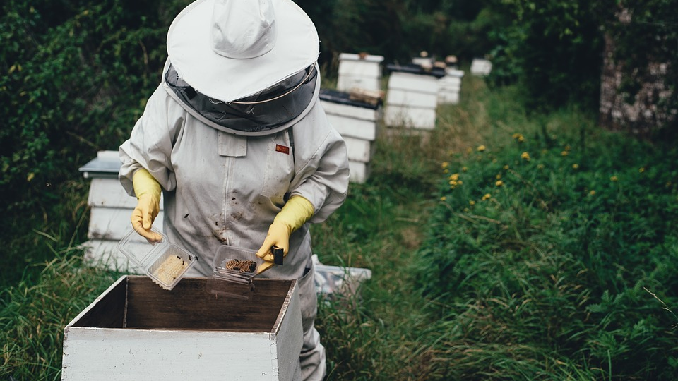
Data Visualizations

Slide 6
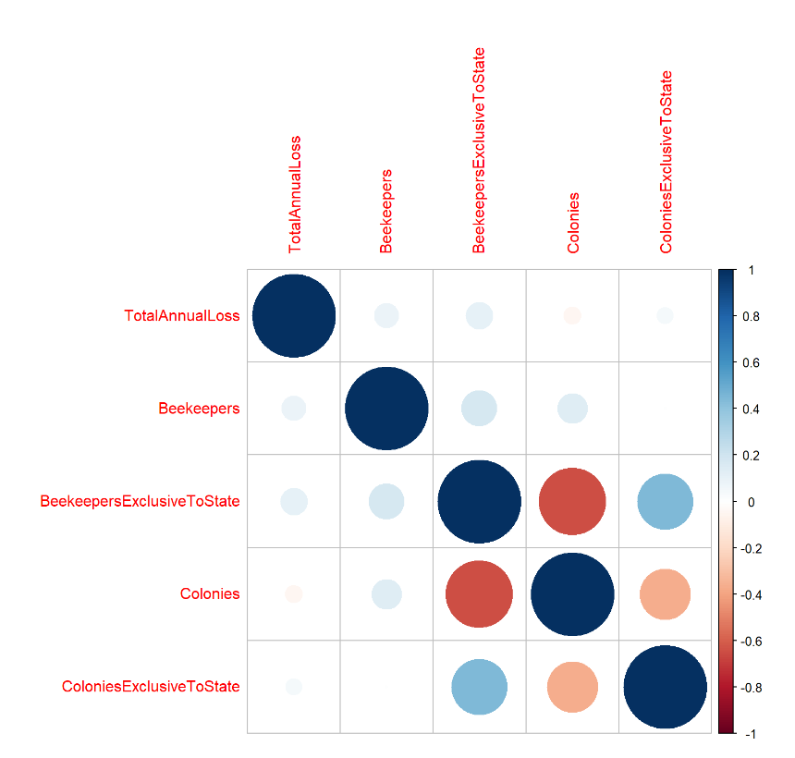

Slide 7
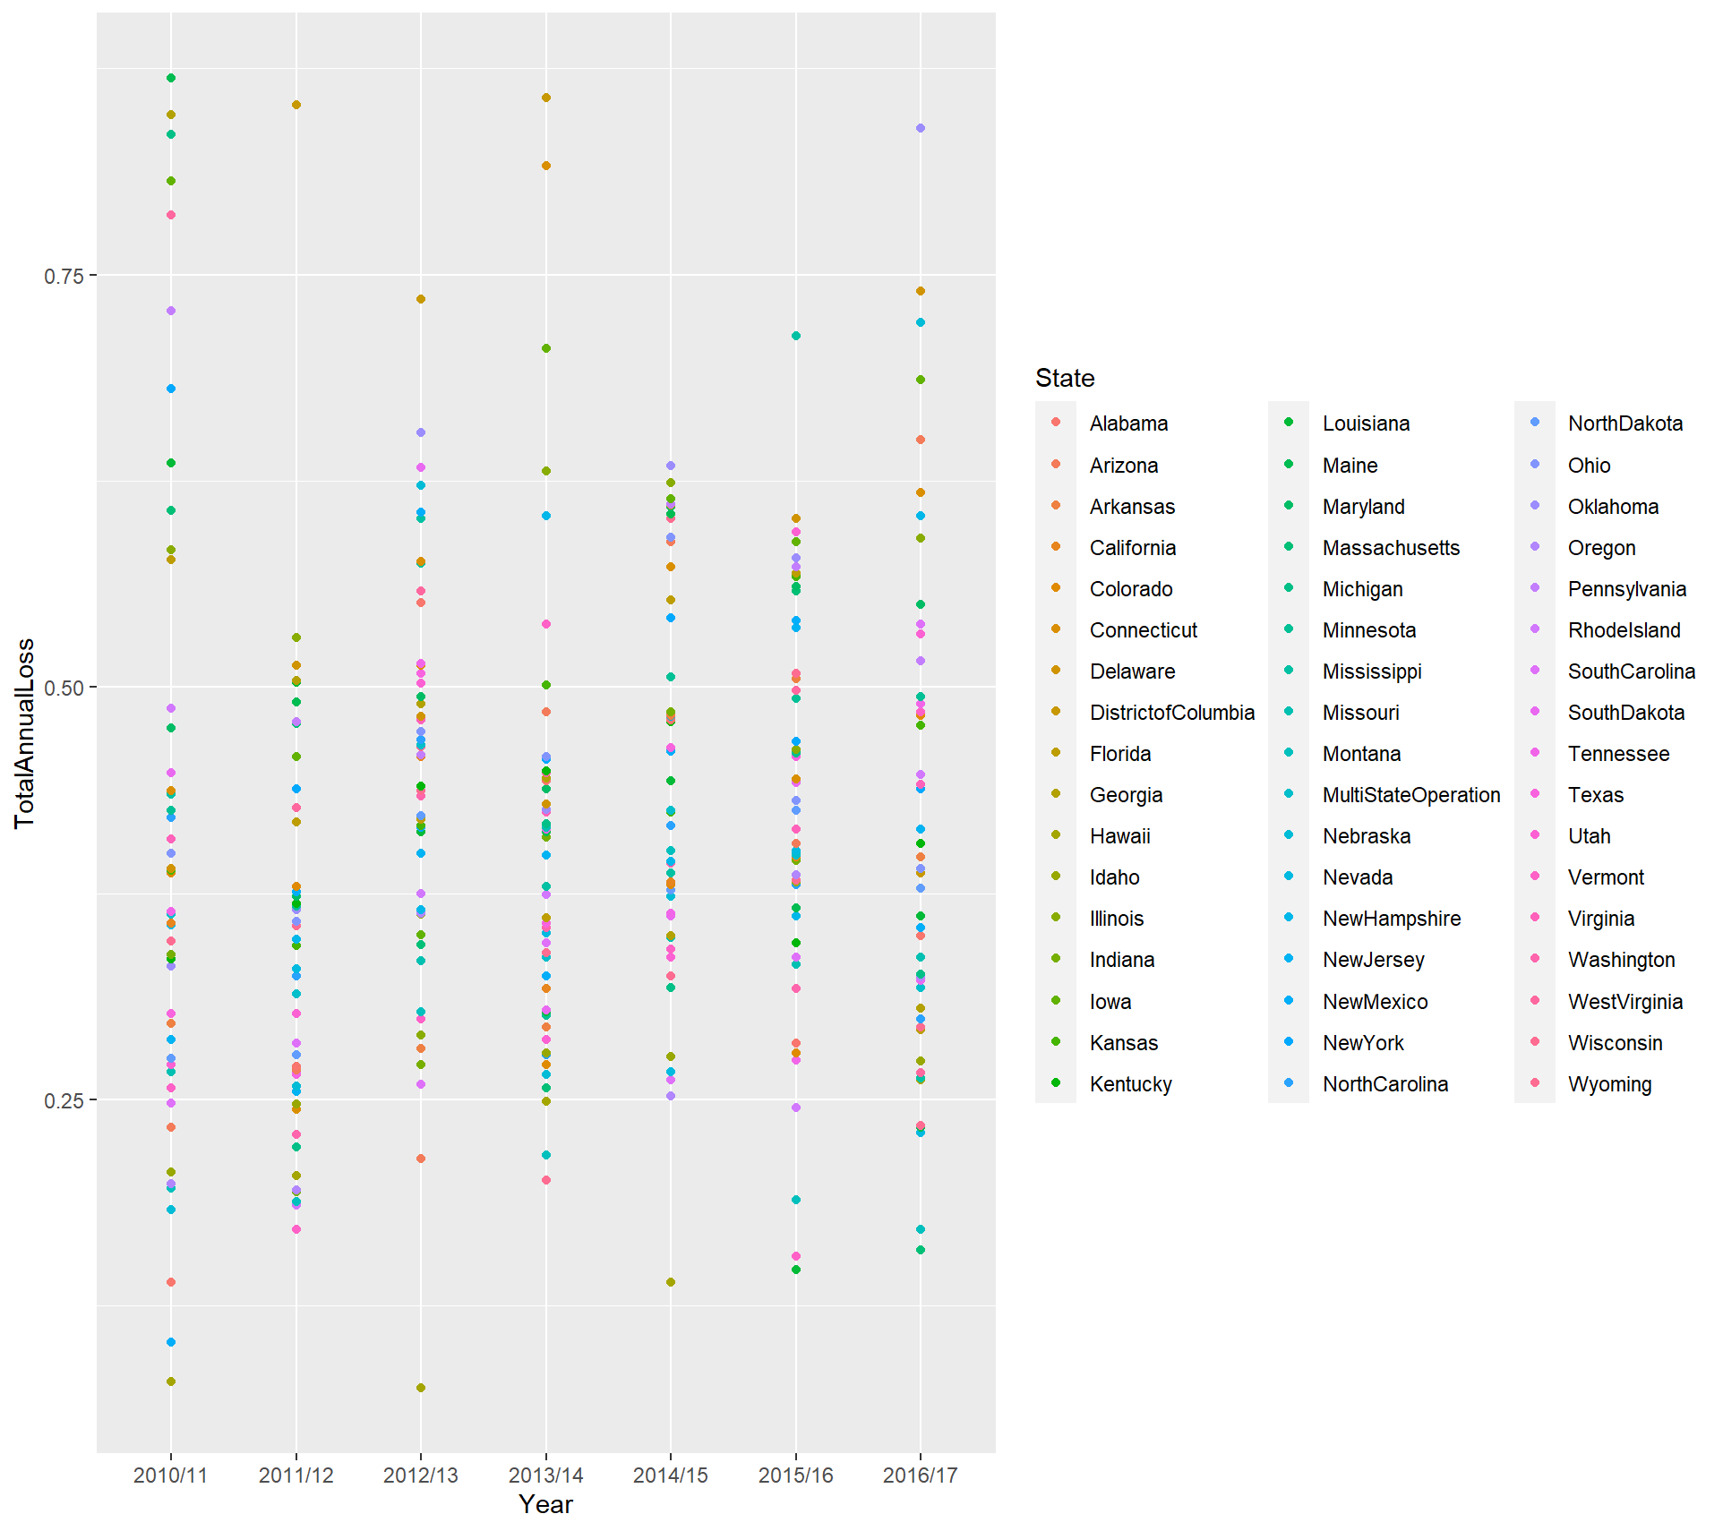

Slide 8
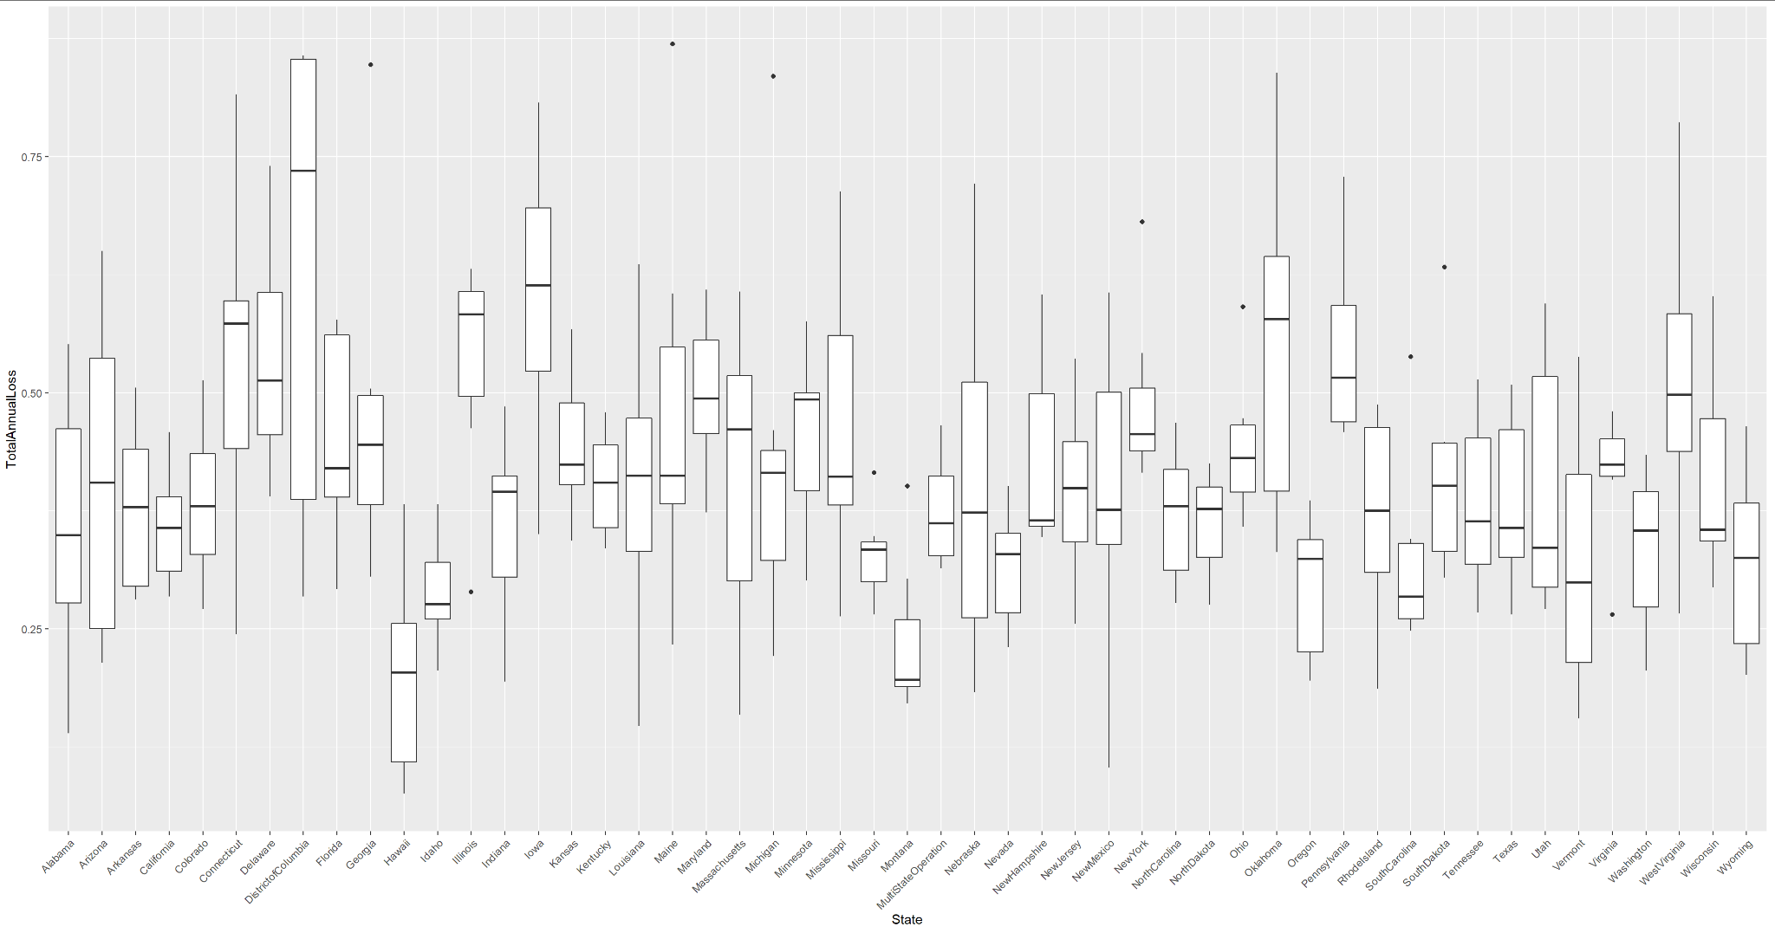

Slide 9
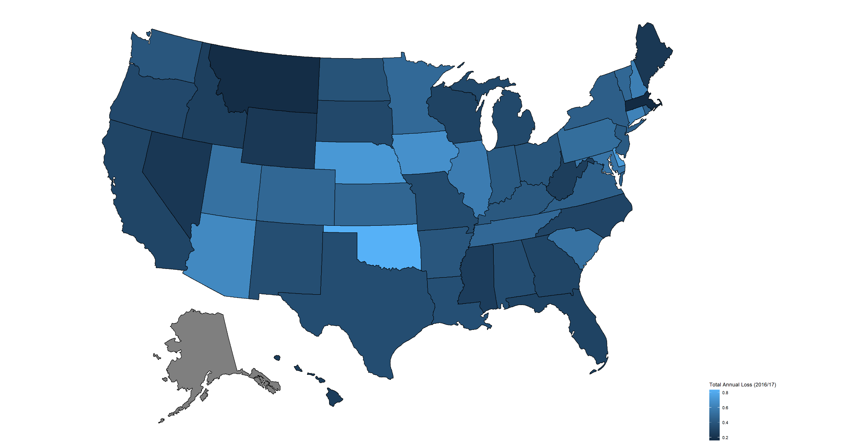

Slide 10
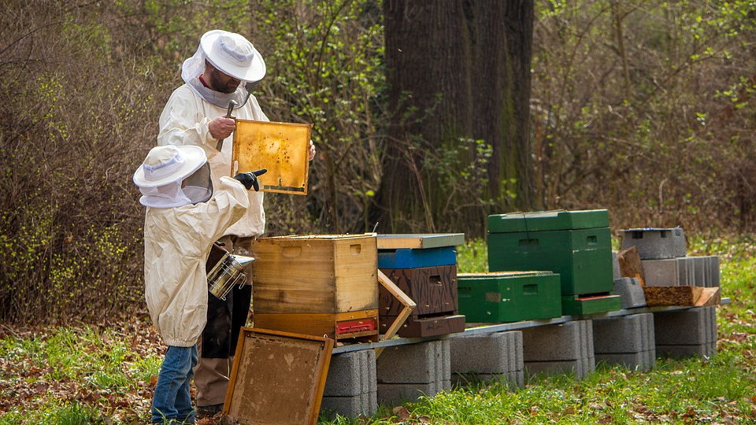
Statistical Analysis

Slide 11
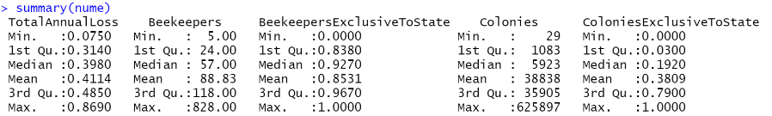
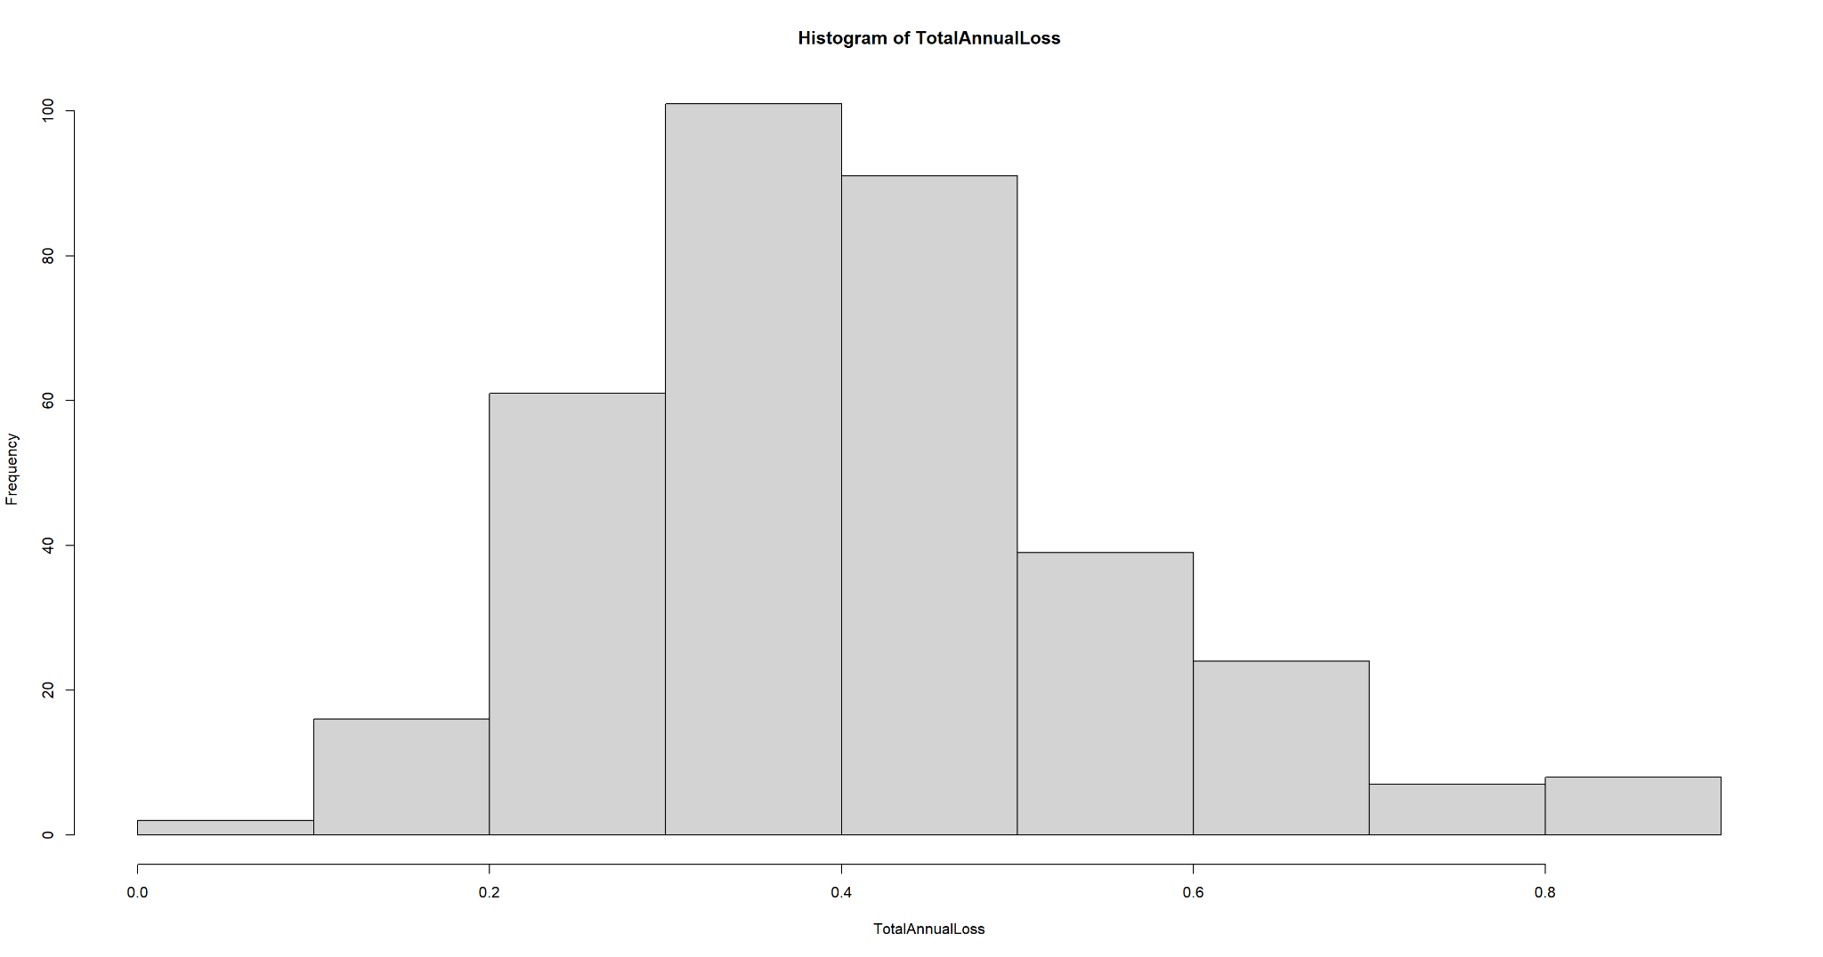

Slide 12
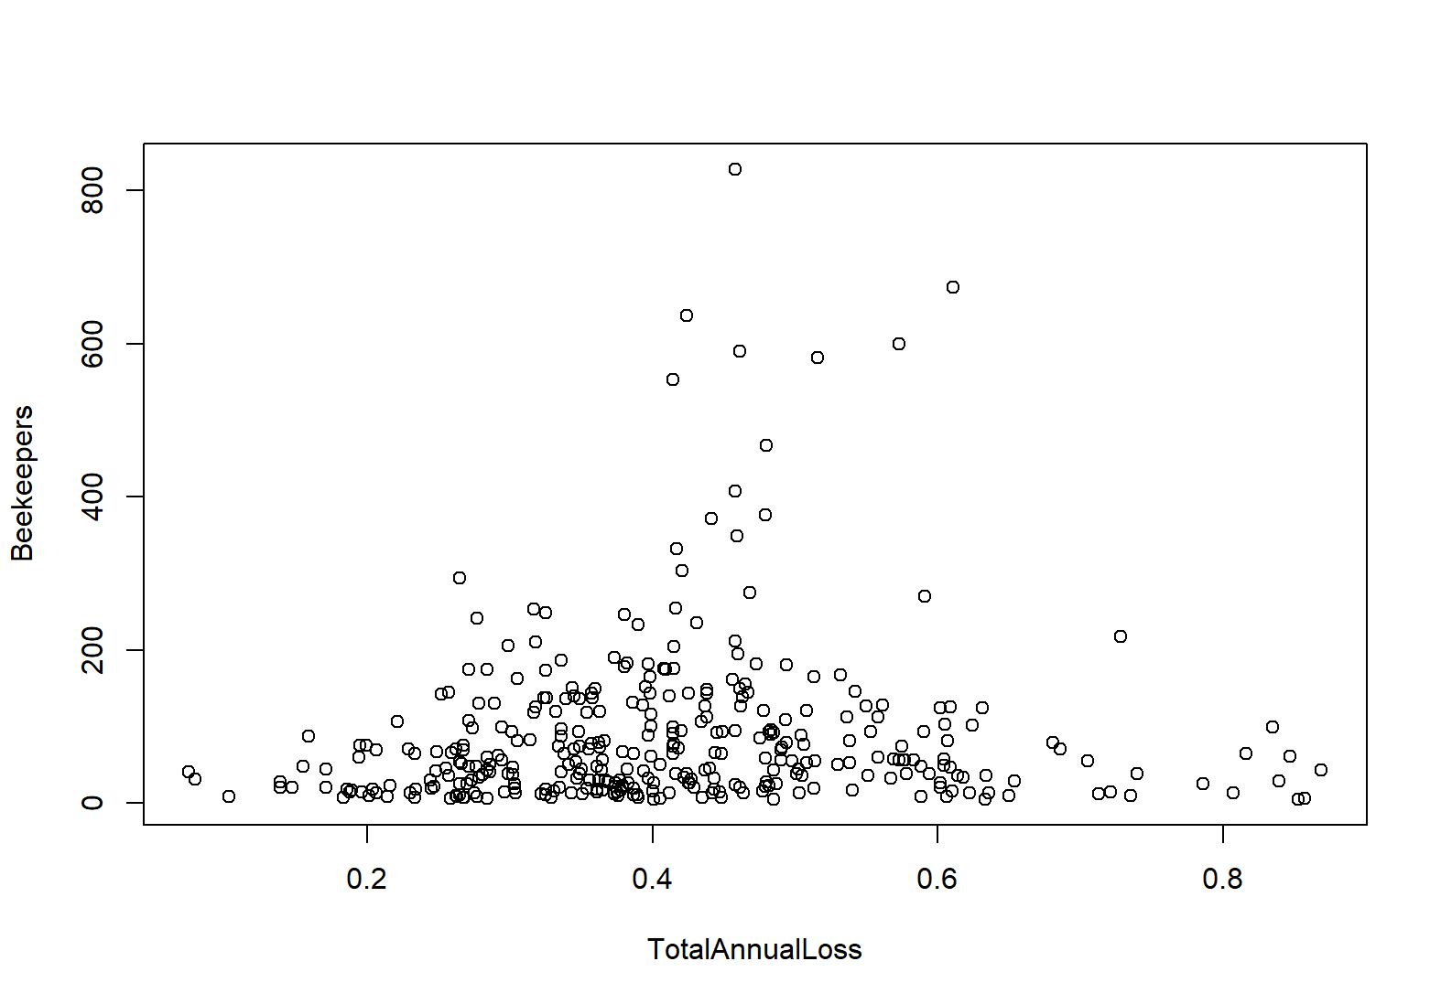
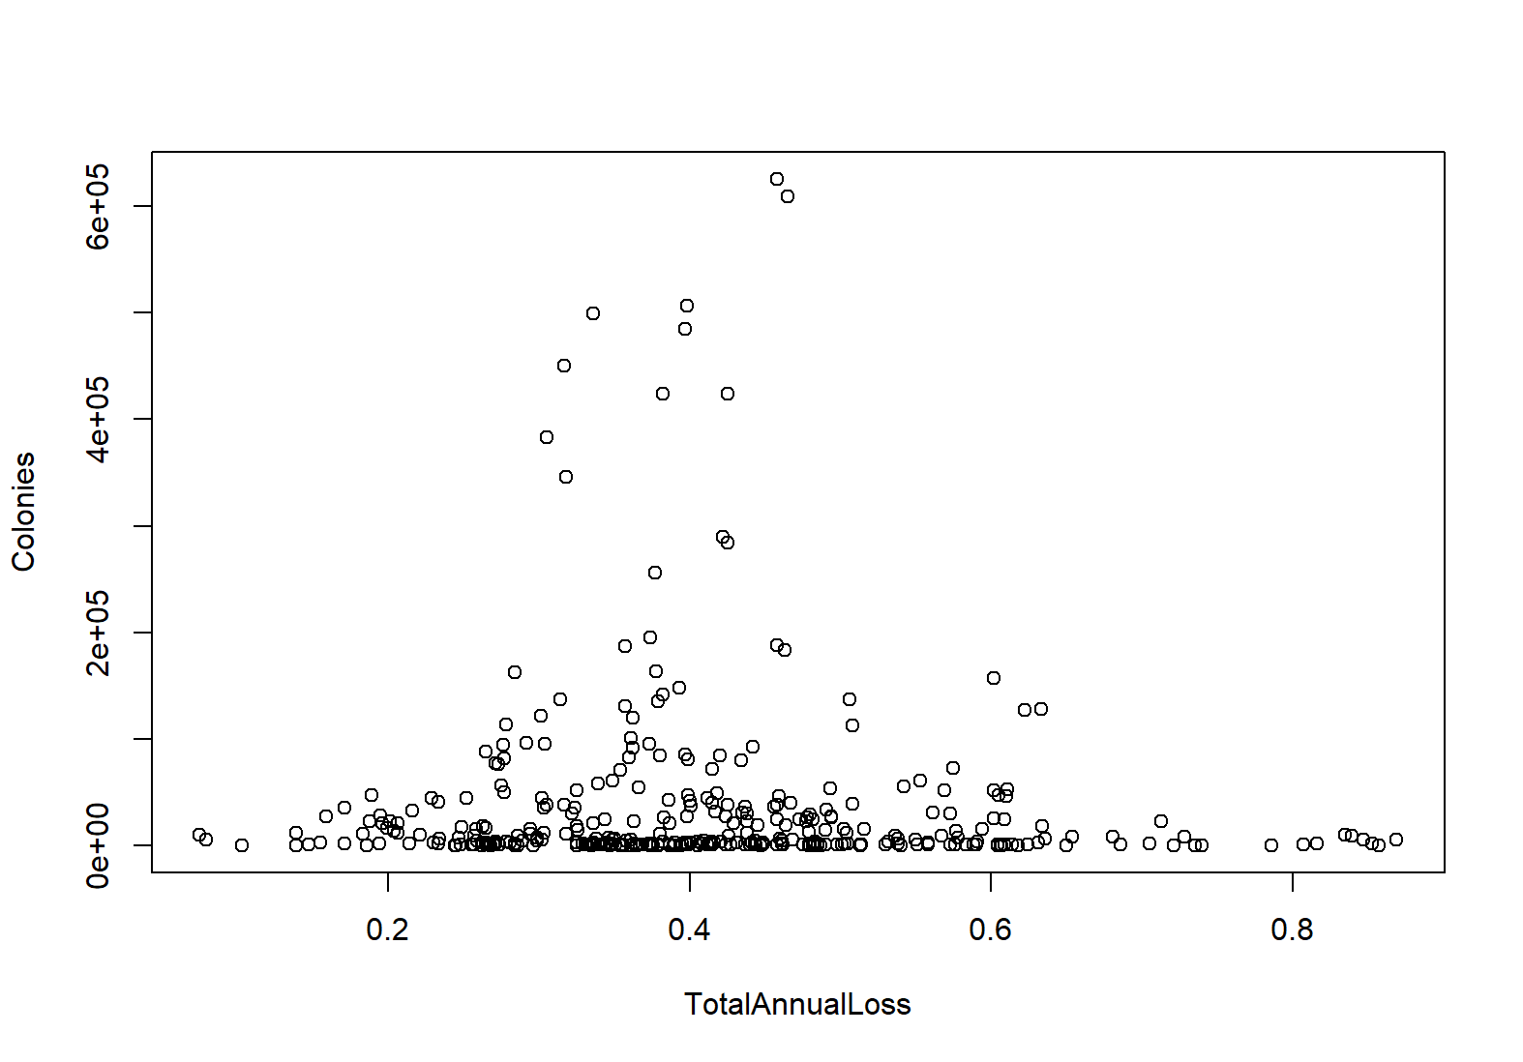

Slide 13
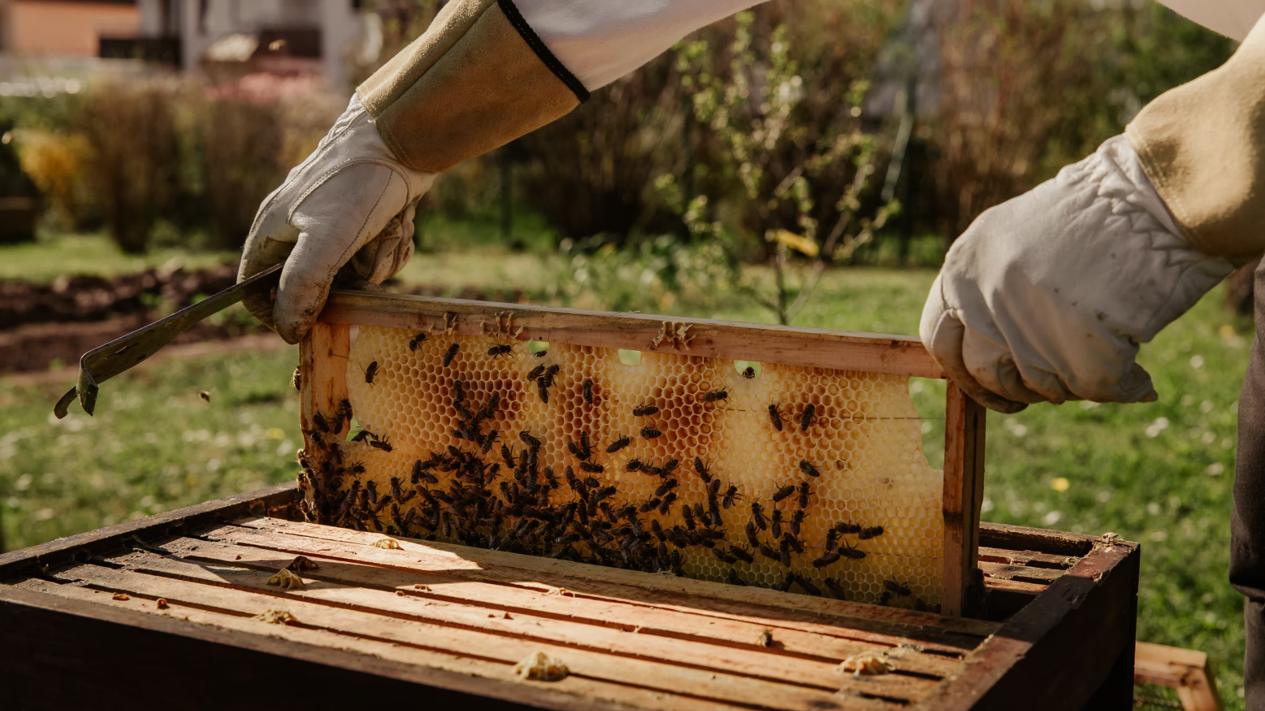
Data Mining

Slide 14

Data Mining Questions
Can we predict the state?
Can we predict the rate of annual loss based on the other numeric values?

Slide 15
Can We Predict the State?
Algorithm/Testing Option | J48 | REPTree | PART | OneR | Naive Bayes
Cross-Validation: 5 | 19.1% | 1.4% | 15.2% | 6.6% | 24.9%
Cross-Validation: 10 | 21.8% | 0.0% | 14.3% | 7.4% | 25.5%
Cross-Validation: 20 | 21.8% | 0.0% | 14.9% | 5.2% | 24.9%
Percent Split: 50 | 14.9% | 0.6% | 6.9% | 1.1% | 14.9%
Percent Split: 66 | 10.1% | 0.0% | 4.2% | 3.4% | 16.0%
Percent Split: 75 | 16.1% | 0.0% | 4.6% | 4.6% | 24.1%

Slide 16
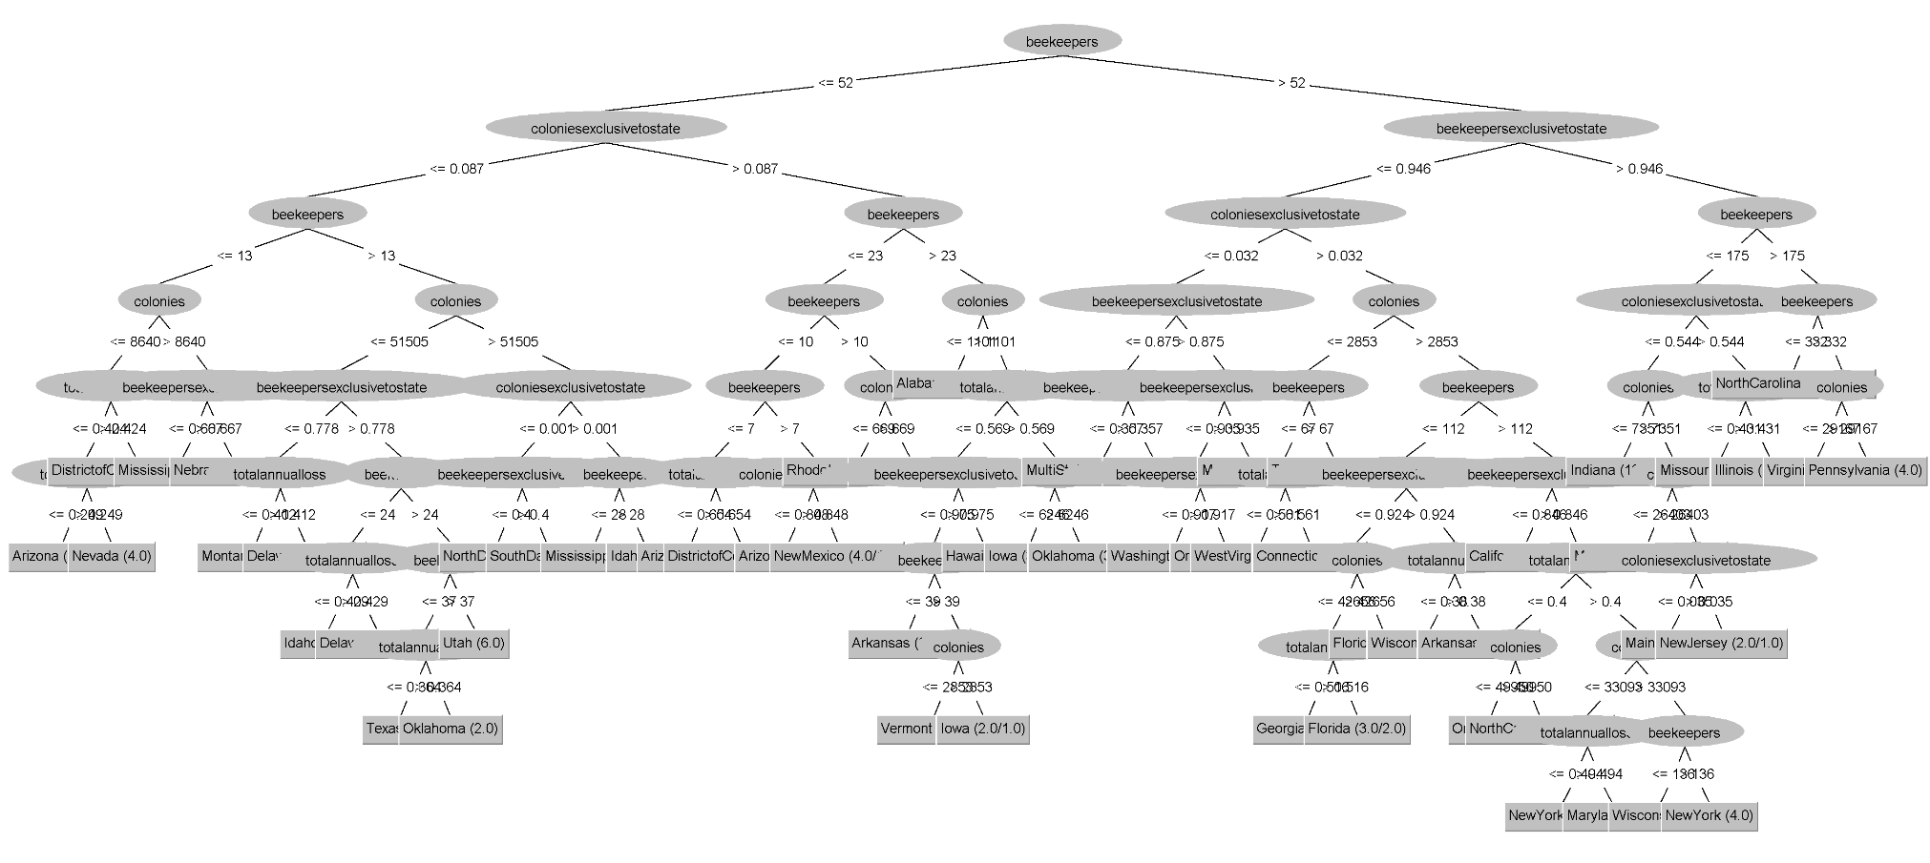
J48 Tree Visualization

Slide 17
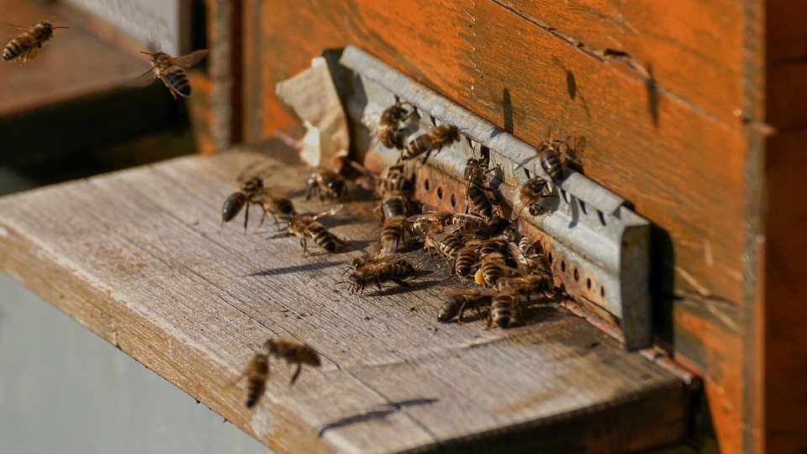
Result: No, we cannot.

Slide 18
Can We Predict the Total Annual Loss?
Percentage Split 66%
Algorithm/Results | Linear Regression | Simple Linear Regression | SMOreg | Multilayer Perceptron | Gaussian Processes
Mean Absolute Error | 0.11 | 0.12 | 0.12 | 0.13 | 0.12
Root Mean Squared Error | 0.15 | 0.15 | 0.15 | 0.18 | 0.15
Relative Absolute Error | 99.5% | 99.5% | 99.6% | 113.7% | 99.4%
Root Relative Squared Error | 99.9% | 99.9% | 100.9% | 119.2% | 99.5%

Slide 19

Problems
Further Research
Not first data set
Broad scope
Too little information
Include more recent data
Include data about weather, parasites, etc.

Slide 20
Resources
Data Set
File - data.world (https://data.world/makeovermonday/2018w18-bee-colony-loss)
Data - beeinformed.org (https://bip2.beeinformed.org/loss-map/)
Tools
Weka
R (RStudio)
Helpful Websites
Mapping - cran.r-project.org (https://cran.r-project.org/web/packages/usmap/vignettes/mapping.html)
Correlation Plot - r-coder.com (https://r-coder.com/correlation-plot-r/)
Pictures
https://www.pexels.com/
https://pixabay.com/
https://unsplash.com/

Slide 21
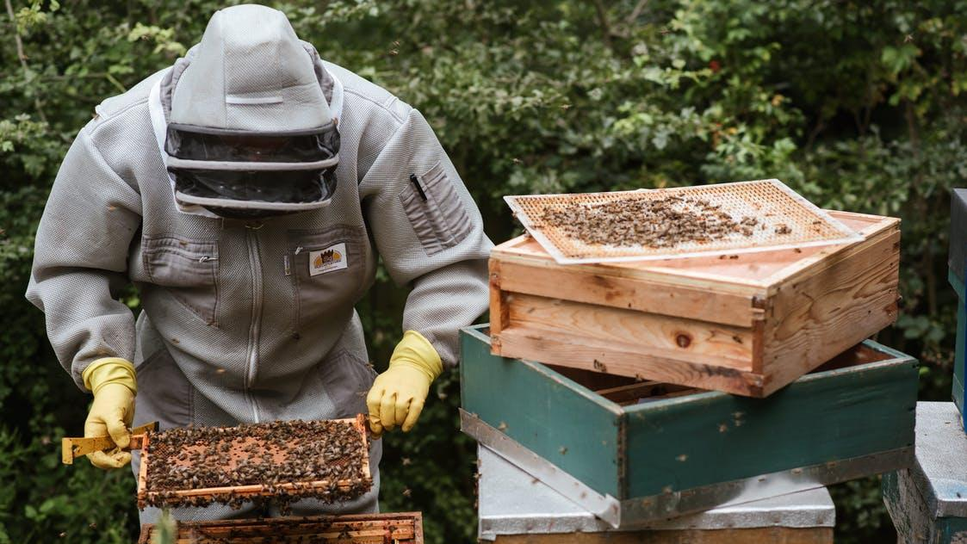
Thank You!

